Slide 1
Software Design
UML
Slides are adapted from various software engineering classes offered by Prof. Tao Xie at UIUC

Slide 2
Modeling notations
Used for both requirements analysis and for specification and design
Useful for technical people
Provide a high-level view
Require training
Many notations
Each good for something
None good for everything

Slide 3
Modeling notations
Help developers communicate
Provide documentation
Help find faults (tools check for consistency)
Generate code (with tools)

Slide 4
UML
Unified Modeling Language
Developed initially by Grady Booch, Ivar Jacobson, and James Rumbaugh
Set of graphical notations
Class diagrams
Sequence diagrams
State diagrams
…

Slide 5
UML class diagrams
Most widely used UML diagrams
Descendent of Entity-Relationship (ER) Diagrams
Describe data and operations

Slide 6
Elements of UML class diagram
Class
Attributes
Operations
Associations
Multiplicity
Direction
Aggregation/composition
Generalization

Slide 7
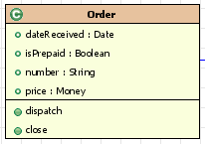
Class
name
attributes
operations
A class encapsulates state (attribute) and behavior (operations).
Each attribute has a type.
Each operation has a signature.
The class name is the only mandatory information.
Notes:
Classes are shown in a box. Each box is divided up into three compartments: the name of the class (in bold), its attributes [click], and its operations [click]. The only mandatory information is the name of the class. Often during high level design, only the class name is filled out. When design proceeds to lower level design, information about the necessary properties and operations start to emerge and be recorded in the class diagram.

Slide 8
Attributes
attributes
Visibility name: type multiplicity = default {property string}
- name: String [1] = “Untitled” {readOnly}
Notes:
Attributes are the data members of a class. There is a specified notation for attributes, as shown in the first line. An example of the use of the full notation appears in the second line. All of the fields of the notation are optional with the exception of the name.
[click] The visibility field indicates if the attribute is public or private. The example attribute on the second line is private – you can tell by the minus sign before the name. If this attribute was public there would be a + before the name.
[click]The next field is the name – the only mandatory field.
[click] The next field, after the semi-colon is the type of the attribute – which places a restriction on the type of object that may be placed in the attribute.
[click] Next, the multiplicity appears in square brackets – I’ll explain multiplicity more in a moment.
[click] Next is the default value for a newly-created object if the attribute isn’t specified during creation.
[click] Finally the {property string} allows you to indicate additional properties for the attribute. For example the {read only} indicates that the clients may not modify the value of the attribute.
In the example in the figure, only the name and type are shown. As I said, only the name is required.

Slide 9
Operations
operations
visibility name (parameter list) : return type {property string}
Parameter list: direction name: type = default value
in date:Date
+ balanceOn (date: Date) : Money
Notes:
Operations are the actions that the class knows to carry out . . . Essentially the methods of the class. Generally in a class diagram you would not show getter or setter methods – only operations that do more interesting things
Similar to attributes, there is a specified notation for operations – again only the name is a required field. The first line here shows the full syntax, the second an example.
[click] The visibility indicates if the method is private or public. The example on the second line shows the method is public – you can tell by the plus sign.
[click] The next field is the name of the method – the only required field . . . The methods in the figure only show the name.
[click] Next is the parameter list. The parameter list has its own syntax.
[click] The first field is the direction. The direction indicates whether the parameter is input – shown by the word in (like the example) or output (as indicated by the word out) or both (shown by the word inout).
[click] Next is the name of the parameter.
[click] and the type of the parameter
[click] and finally a default value for the parameter.
[click] going back to the operation syntax – the next field is the return type of the method.
[click] and finally there can be a property string which indicates any properties that apply to the method.
That concludes the types of information that are in the class boxes themselves. Now we will look at the relationships that can occur between classes.

Slide 10
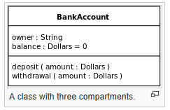
Class

Slide 11
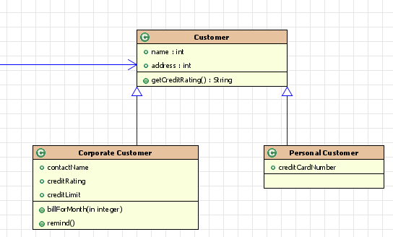
Generalization
is -a
is -a
Generalization relationships denote inheritance between classes.
The children classes inherit the attributes and operations of the parent class.
Indicated by a hollow arrow
Notes:
The first relationship is the generalization relationship – which indicates inheritance or sub and super classes. Generalization is shown by a hollow arrow. In this case both Corporate Customer and Personal Customer inherit from the Customer Class. This relationship indicates that the Corporate and Personal Customers have differences but also many similarities. The similarities are placed in the super class – Customer. The differences are put in the subclasses Corporate Customer and Personal Customer.
[click] Often generalization is referred to as a “is-a” relationships . . . A Corporate Customer “is-a” Customer. A Personal Customer “is-a” Customer.

Slide 12
Generalization/Inheritance
Claim
Plan
Claim Image
*
image
0..1
date: Date
procedure: String
supplies: String
price: Integer
name: String
ID: String
0..1
claim
*
Provider
name: String
address: String
phone: String
Fax Image
Scanned Image

Slide 13
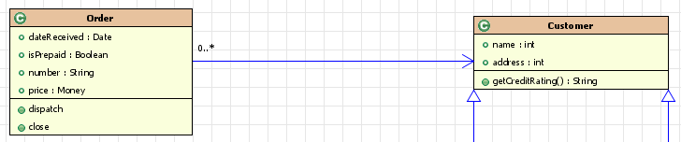
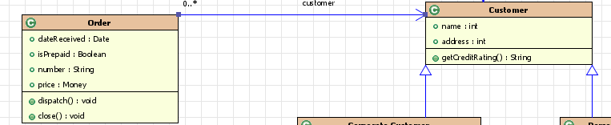
Association
Indicated by a solid arrow line from the source (holding) class to the target class (being held)
Can be bi-directional represented by lines without arrow heads
has-a
Don’t usually put the association down as an attribute in the class
Notes:
An association is a solid line between the classes, from the source class to the target class. Associations can be thought of as “has-a” relationships between classes. [click] An order “has-a” customer associated with it
What does this mean in the code? It means that an instance of the Order class will have a data member that has the type Customer. Since you have the arrow on the diagram, you don’t usually put the association down as an attribute in the class.
[click] You can put the name of the attribute at the target end of the arrow as shown here.
You can have bidirectional associations – meaning that each class “has-a” instance of the other class as a data member. These appear as lines with no arrow heads. For example a bidirectional association between orders and customers would mean that the customer class would keep track of the orders of a customer in addition to every order keeping track of the customer that placed the order.

Slide 14
Attributes vs. associations
Claim Image
Plan
Claim
*
ID: String
0..1
0..1
date: Date
*
*
Procedure
Provider
name: String
supplies: String
price: Integer
name: String
address: String
phone: String

Slide 15
Claim class diagram - Multiplicity
Claim
Plan
Claim Image
0..N
0..1
date: Date
procedure: String
supplies: String
price: Integer
name: String
ID: String
0..1
0..N
Provider
Multiplicity
0..1 or 0..N is optional
1 is mandatory
* means 0..N
name: String
address: String
phone: String

Slide 16
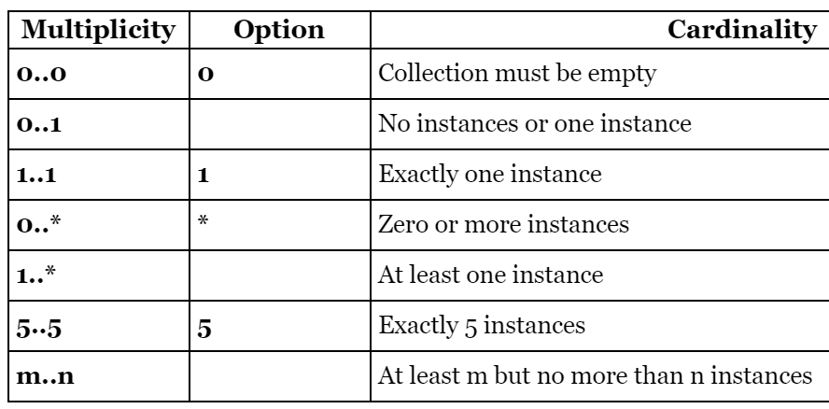
Claim class diagram - Multiplicity
http://www.uml-diagrams.org/multiplicity.html
Multiplicity: “An association end can have a multiplicity. The multiplicity of an association end is the number of possible instances of the class associated with a single instance of the other end. Multiplicities are numbers or ranges of numbers.”
Question to you: How to interpret “0..*” on both ends?!
http://docwiki.embarcadero.com/RADStudio/Seattle/en/Class_Diagram_Relationships_(UML_1.5)

Slide 17
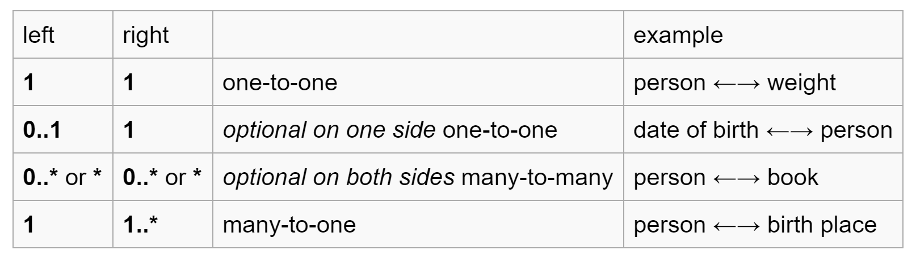
Claim class diagram - Multiplicity
Not very good examples
..*
Multiplicity
0..1 or 0..N is optional
1 is mandatory
* means 0..N

Slide 18
Claim class diagram - Multiplicity
What if not specified?!
“There isn't a real default.”
“So in the absence of any other knowledge an association with unspecified multiplicities is interpreted as many-to-many.”
“So you better specify your multiplicities somewhere even if the association is many-to-many to avoid any confusion.”
http://www.coderanch.com/t/100225/patterns/defualt-multiplicity

Slide 19
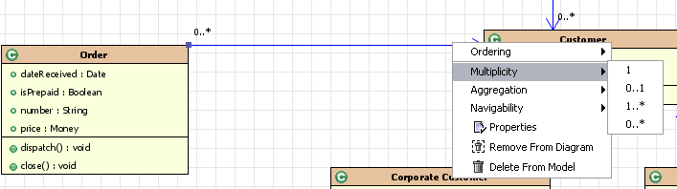
Multiplicity
Notes:
The Multiplicity of a property is an indication of how many objects may fill the property. In the figure, the multiplicities indicate that one customer can have 0 to many orders. No multiplicity is shown near the Customer because the default multiplicity is 1.
[click] shown here are some typical multiplicities. In this screenshot, these are the default multiplicities that can be chosen in the MyEclipse tool. 1 means you can have one object – such as one customer. 0 .. 1 means that you may or may not have the object, but you can have at most one. 1..* indicates that you must have at least one object but you may have many. And finally, 0 .. * indicates you can have none of the object but you can have many as well.

Slide 20

Aggregation vs. Composition Part-Whole hierarchy
Aggregation: stronger association (unidirectional)
Ex. A dept contains a set of employees
A white diamond at the end of the association next to the aggregate class
Composition: stronger aggregation (unidirectional)
Ex. Invoice–InvoceLine
A black diamond on the end of association next to the composite class

Slide 21
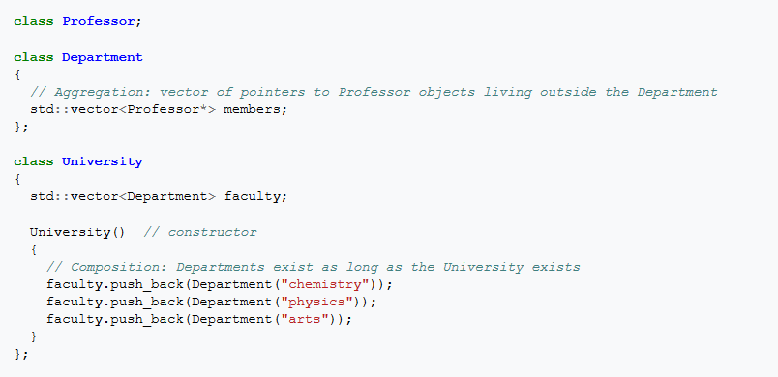
Aggregation vs. Composition Orthogonal to Multicity!
Aggregation vs. Multicity
Composition is usually implemented such that an object contains another object.

Slide 22
Aggregation vs. Composition Orthogonal to Multicity!
Composition vs. Multicity
Association (no diamond) is the most general form, allowing cardinality and navigability to be defined at both ends.
Composition (filled diamond) is a whole-part relationship where the 'whole' (end with the black diamond) 'contains' the part. It imposes two key restrictions:
There can only be 1 container (i.e. cardinality at whole end is exactly 1);
It imposes a lifecycle responsibility for parts on the whole. So the container is responsible for creating and deleting parts. A part cannot continue to exist if its container is deleted.

Slide 23
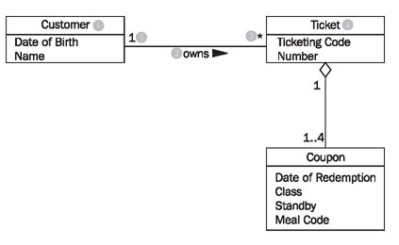
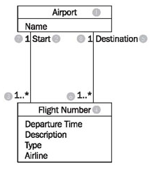
Reading Class Diagrams

Slide 24
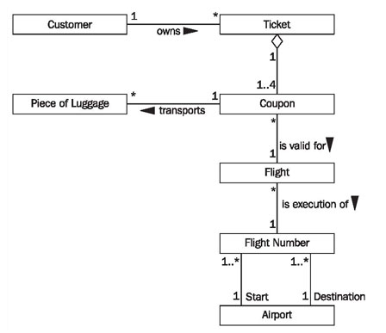
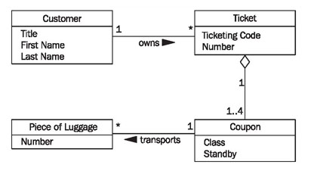
Constructing Class Diagrams

Slide 25
OO modeling points
Best objects correspond to real-world entities
Some correspond to actors (adjudicator)
They are actually interfaces to the actors
Some correspond to complex processes, but this is an exception, and should not be common

Slide 26
Health Claims Processing: Some Requirements
Receives health claims and supporting documents via many sources: electronically, fax, on paper
Scanned paper and fax processed by OCR. Documents first subject to form dropout, deskewing, despeckling
All images are logged to optical disk

Slide 27
Behavior
Claim Image
Plan
Claim
*
ID: String
0..1
name: String
0..1
date: Date
*
form_dropout()
deskew()
despeckle()
log()
Provider
name: String
address: String
phone: String

Slide 28
OO modeling points
Class names should be nouns
Avoid generic names that don’t describe the class, e.g., names ending in “er” (Manager, Handler)
Operation names should be verbs

Slide 29
Analysis vs. Design
Class diagrams are used in both analysis and design
Analysis - conceptual
Model problem, not software solution
Can include actors outside system
Design - specification
Tells how the system should act
Design - implementation
Actual classes of implementation

Slide 30
Example analysis model

Slide 31
Temporary vs. permanent
Most class diagrams are temporary
Boxes and lines
Gradually add
More classes
Attributes
Labels/cardinality of associations
Most class diagrams only show small part of model

Slide 32
Extending class diagrams
No modeling notation can do everything
Modeling notations should be extensible
UML has two techniques
Constraints
Stereotypes

Slide 33
Constraints
Claim Image
Plan
Claim
*
ID: String
0..1
name: String
0..1
date: Date
*
form_dropout()
deskew()
despeckle()
log()
{Provider is legal under plan}
Provider
name: String
address: String
phone: String

Slide 34
Stereotype
<<Remote>>
Plan
Claim Image
Claim
*
0..1
name: String
ID: String
0..1
date: Date
*
form_dropout()
deskew()
despeckle()
log()
Provider
name: String
address: String
phone: String
«control», a class, an object of which denotes an entity that controls interactions between a collection of objects
«entity», a class that represents a domain-specific situation or a real-world object and that does not initiate interactions
«boundary», a class that lies on the periphery of a system but within it

Slide 35
Class diagram
Central model for OO systems
Describes data and behavior
In UML, is used along with Use Cases and Packages for analysis
Can be used to describe implementation
Don’t confuse analysis & implementation!
HW3: don’t build UML diagrams from code!

Slide 36
How to build a UML model?
Depends on the process
RUP – we will see details, rather formalized
Roles, tasks, process…
XP – similar to RUP except that
Everyone does it
Little written, more oral
Less is done before writing code
Many times haphazard way
Ad-hoc build models when needed

Slide 37
Rational Unified Process (RUP)
Designed to work with UML
Was promoted by IBM
Roles - (out of 20 or so)
Architect
UI designer
Use case specifier
Use case engineer
Component engineer

Slide 38
How RUP builds a model
Gather use cases from customer
Make initial object model
For each use case:
Step through use case
Note the objects it requires
Note the operations it uses
Clean up the model

Slide 39
Architect
Determine which use cases need to be developed first
High priority use cases
Describe important and critical functionality
Security
Database
Hard to retrofit later

Slide 40
UI design
Logical design
Which user-interface elements are needed for each use case?
What information does the actor need to receive from or give to the system?
Prototyping
Often is on paper
Test on real users

Slide 41
Requirements specification
Not all requirements go in a use case
Example: security
Example: global performance
Requirements document describes all other requirements that are not suitable for use cases

Slide 42
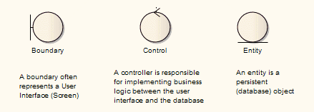
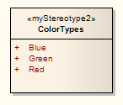
Analysis model
Class diagrams
Vague interfaces (“responsibilities”)
Vague associations (ignore navigability)
Stereotype classes:
Boundary - UI, associated with actor
Control - control associated with a use case
Entity - persistent, the “real” objects
Use-case realization (Analysis)
http://www.sparxsystems.com/enterprise_architect_user_guide/10/standard_uml_models/stereotypedlg.html

Slide 43
Stereotypes
<<control>>
<<boundary>>
<<entity>>
<<boundary>>
<<boundary>>

Slide 44
Packages
Logical grouping
Used to
Divide large system into smaller subsystems
Show dependencies between subsystems
Can contain
Class diagrams or packages
Use cases, sequence diagrams, etc.

Slide 45
Packages example
“Facade is a stereotyped package containing nothing but references to model elements owned by another package. It is used to provide a ‘public view’ of some of the contents of a package. A Façade does not contain any model elements of its own.”
http://www.jeckle.de/files/UML1_2/apndxa.pdf

Slide 46
Packages and dependencies
Reduce coupling
Increase cohesion
In packages
Cohesion is between classes in a package
Coupling is between classes in different packages
In classes
Cohesion is between methods in a class
Coupling is between methods in different classes

Slide 47
Architect: responsibilities
Responsible for the integrity of analysis model
Makes sure packages fit together
Makes sure each package is good
Identifies obvious entity classes
Lets other classes be defined during use-case realizations and component analysis

Slide 48
Architect: tasks
Identify common special requirements
Persistence
Distribution and concurrency
Security
Fault tolerance
Transaction management

Slide 49
Use case engineer
Identify analysis classes needed by use-case
Boundary classes, control classes, entity classes
Distribute behavior of use-case to classes
Make use-case realization: a precise description of use-case
Sequence diagram
Collaboration diagram

Slide 50
Component Engineer
Analyze classes
Gather information from use cases
Make sure class is coherent
Make model as simple as possible, but no simpler
Analyze a package
Relationships between classes
Relationships between packages

Slide 51
RUP process for analysis
Find use cases
Architect determines order
Repeatedly,
Take next use case
Change class diagram to accommodate use case
Simplify class diagram

Slide 52
Object diagram
Snapshot of objects in a system at a point in time
If there is just one object of each class, the class diagram and the object diagram are the same
As classes become more reusable, object diagram becomes more interesting

Slide 53
Class diagram
<<control>>
<<boundary>>
<<entity>>
<<boundary>>
<<boundary>>

Slide 54
Class and object diagrams
101:Claim
Jim:Adjudicator
102:Claim
Id:620194211
103:Claim
:Claim Processor
Jan:Adjudicator
104:Claim
Id:301478334
105:Claim

Slide 55
Summary of analysis
Analysis is converting vague user needs into a precise model of what the system should do
Analysis is incremental; look at one piece of the problem at a time
Requires continually changing the model until you are done

